Slide 1
Hospital Management System
By,
WFS8_HYD Team 2

Slide 2

Team : The Null Pointers
K Arshitha
Jaya Shiva Darshini S
Kishan Kaushik Koritala
Harsh Kanodiya
Geetha Sravya Somu
Yenigandla Venislaus Ashish
Sowmiya D
Bhagavatula Yogiraj
Nithin Kumar Uadla

Slide 3


Intro
A Hospital Management System (HMS) is software that integrates and streamlines the administrative, clinical, and financial operations of a healthcare facility. It improves efficiency, enhances patient care, and ensures compliance with healthcare standards.

Slide 4
Features of our project
Responsive
Our application is designed to be fully responsive, ensuring a seamless user experience on any device, whether it's a desktop, tablet, or smartphone.
Secure
We prioritize the security of your data. Our robust security measures protect your information, ensuring a safe platform to use.
Scalable
Whether you're organizing a small gathering or a large-scale conference,our application scales effortlessly to meet the needs of user of any size.
Robustness
Expect a powerful and feature-rich HMS platform. From customizable templates to comprehensive analytics.
Whether you're organizing an intimate gathering or a large-scale conference, our application scales effortlessly to meet the needs of events of any size

Slide 5
Technology Stack Used
Frontend
- HTML - CSS - JAVASCRIPT
Backend
- JAVA
Testing
- JUNIT
Database
- MYSQL - JDBC
Whether you're organizing an intimate gathering or a large-scale conference, our application scales effortlessly to meet the needs of events of any size

Slide 6
ARCHITECTURE

Slide 7
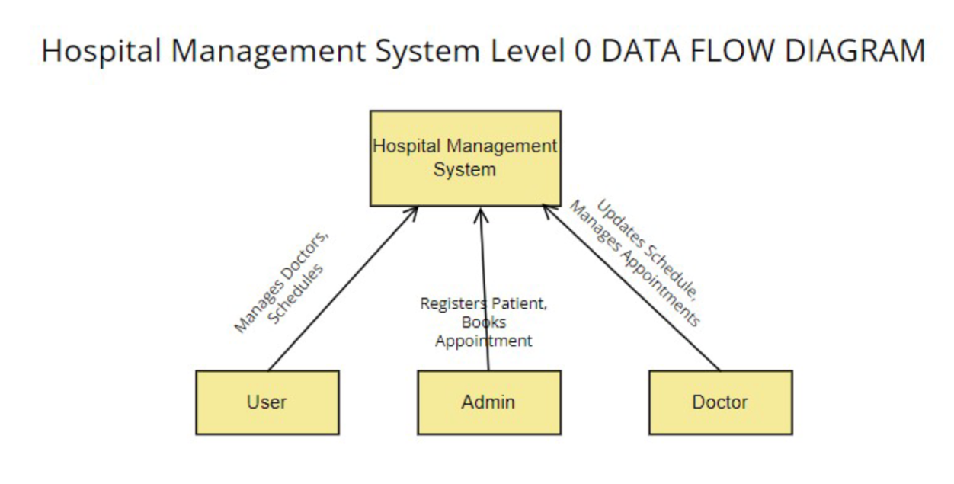
DFD LEVEL 0

Slide 8
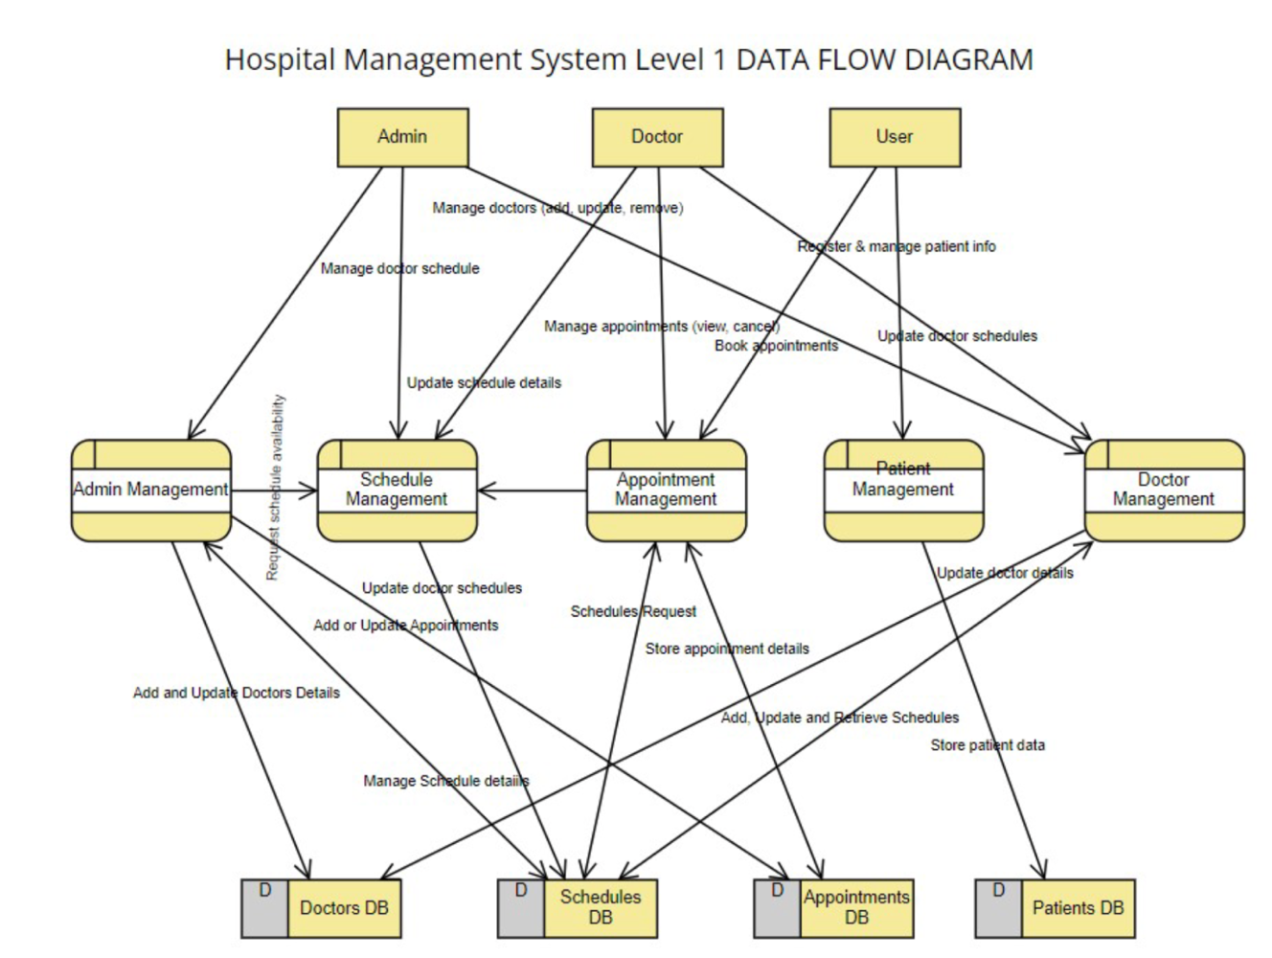
DFD LEVEL 1

Slide 9
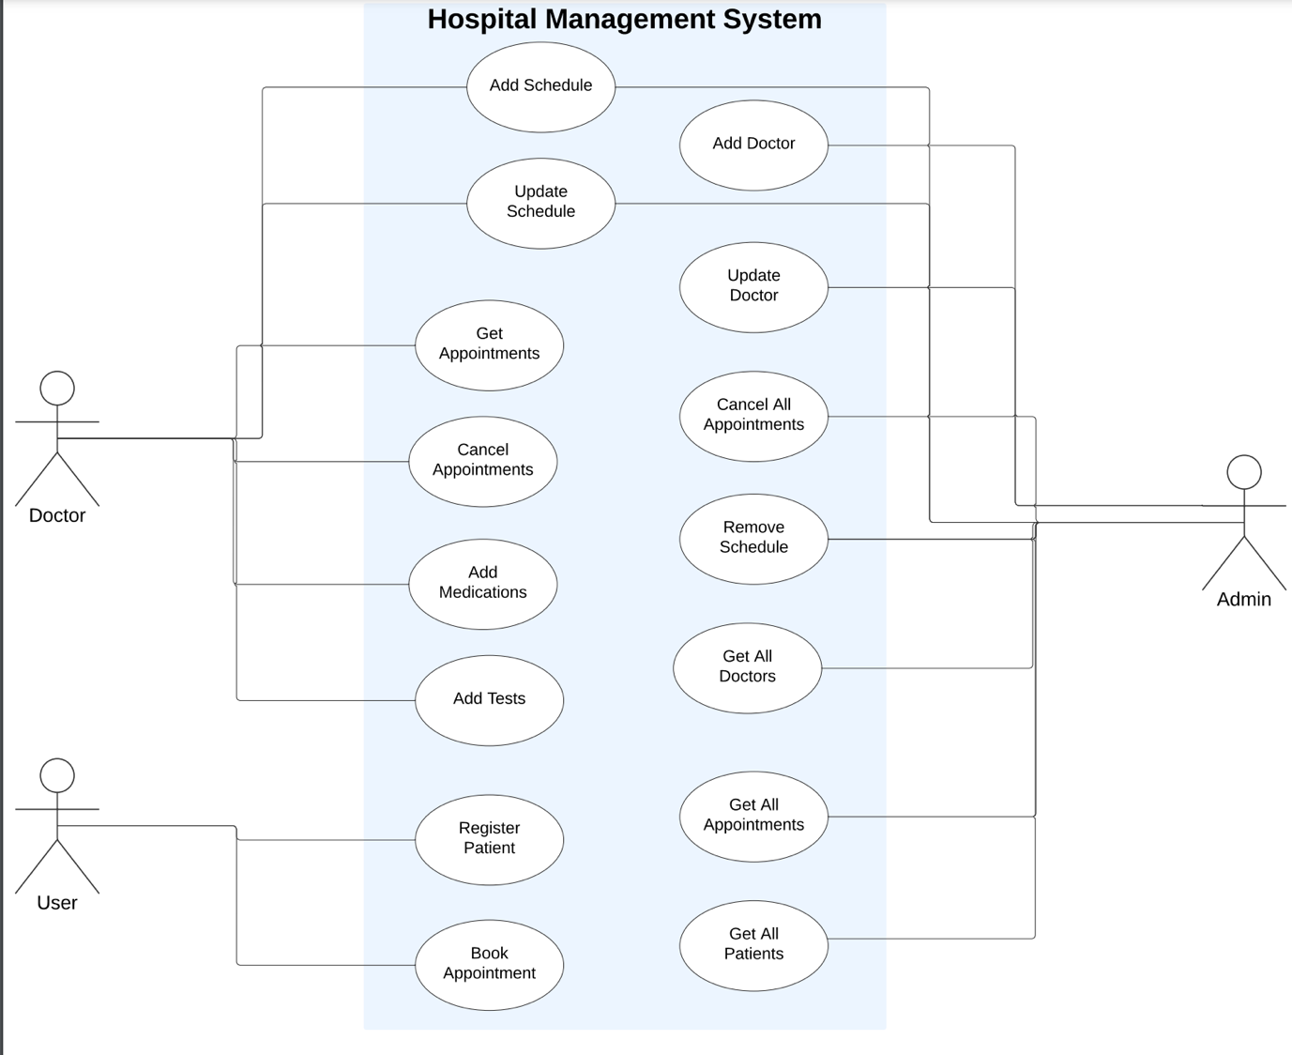
USE CASE DIAGRAM

Slide 10
FRONTEND DESIGN

Slide 11

Home page

Slide 12

Admin login page

Slide 13
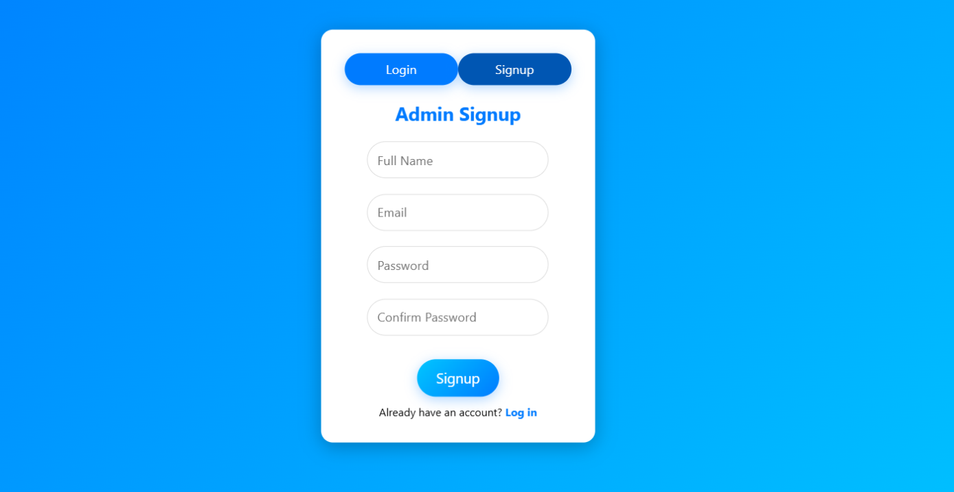
Admin signup page

Slide 14
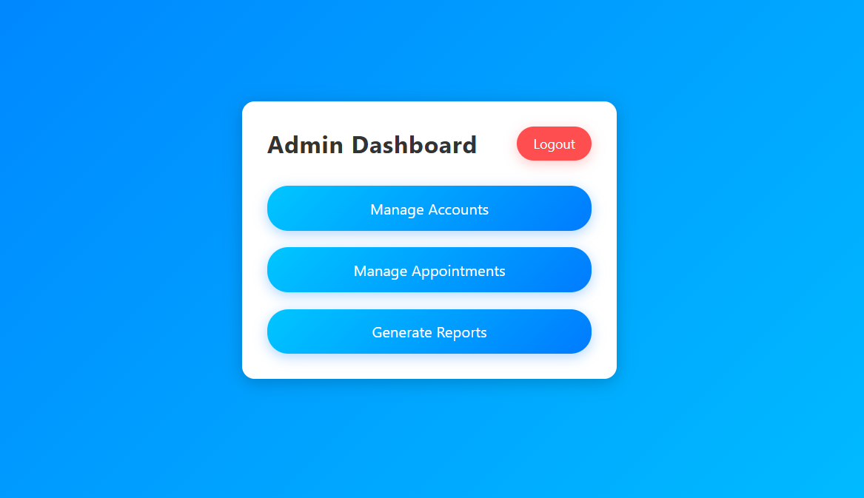
Admin Dashboard page

Slide 15
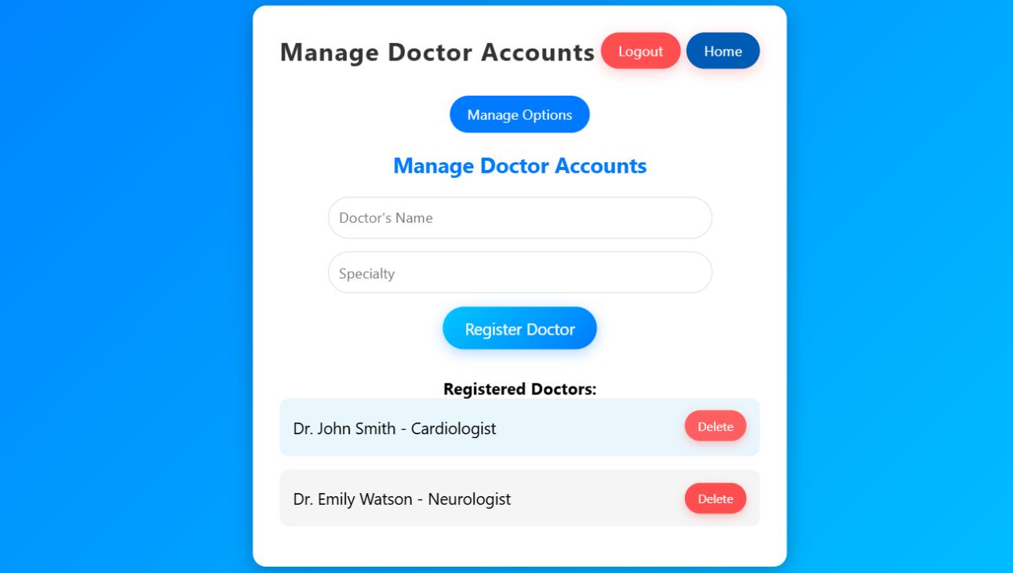
Admin pages

Slide 16
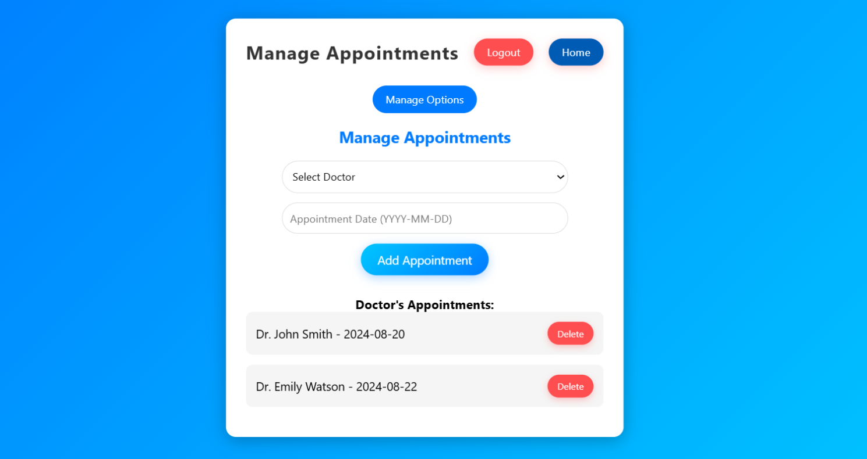
Admin pages

Slide 17
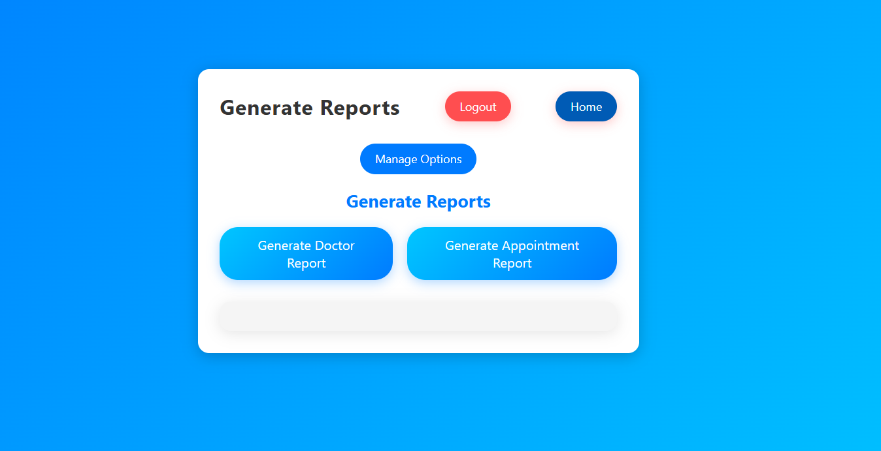
Admin pages

Slide 18
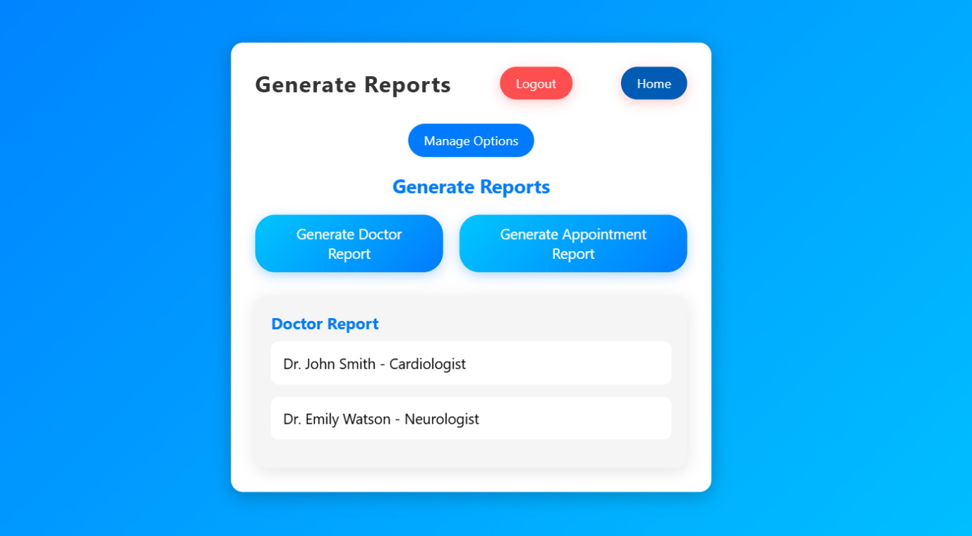
Admin pages

Slide 19
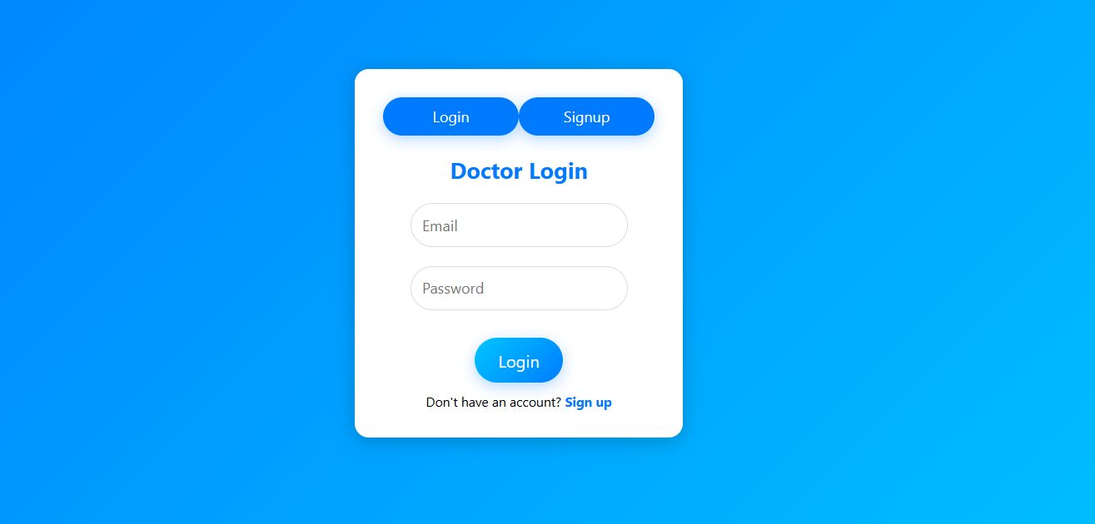
Doctor login page

Slide 20
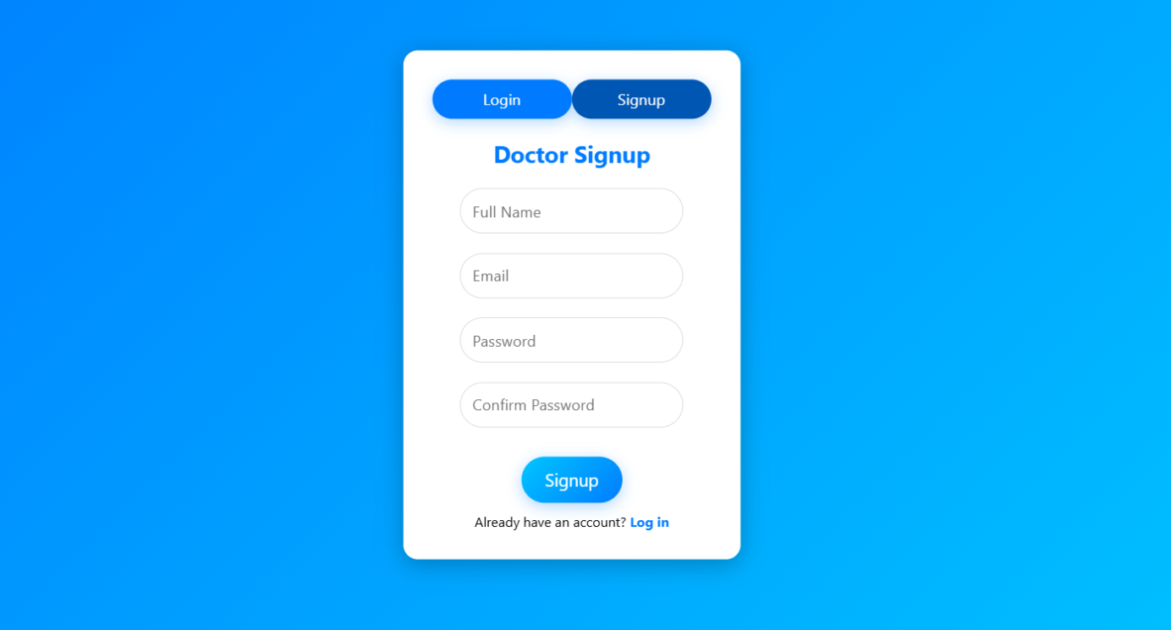
Doctor Signup page

Slide 21
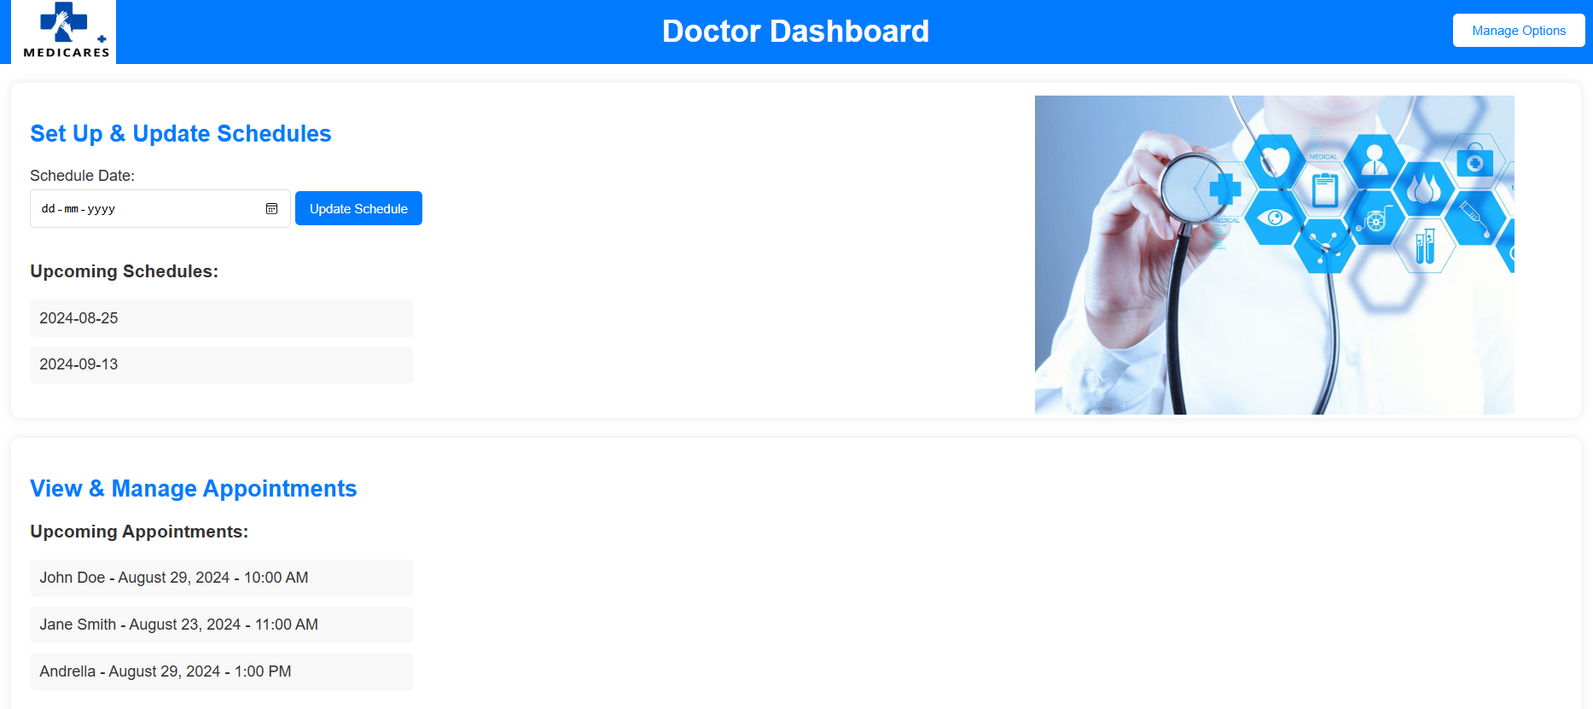
Doctor Dashboard page

Slide 22
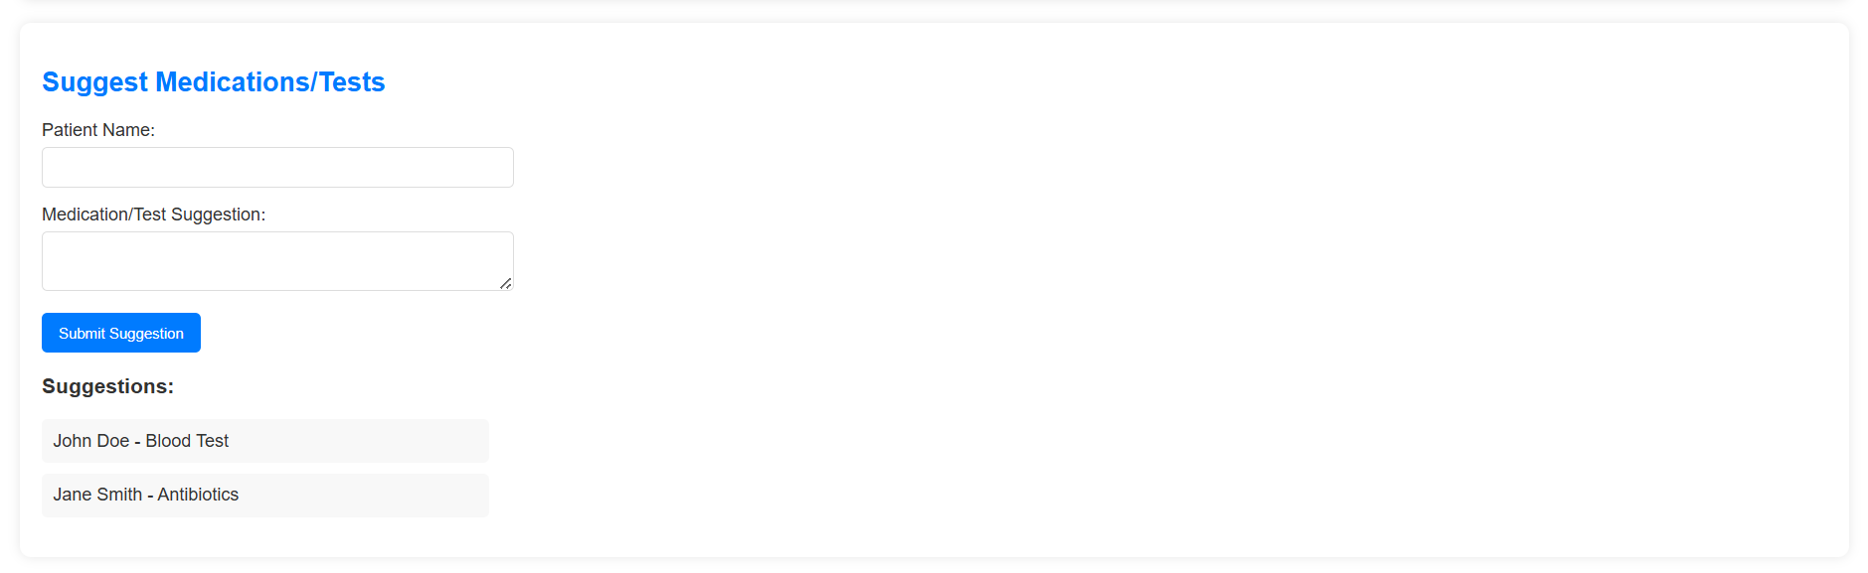
Doctor Dashboard page

Slide 23
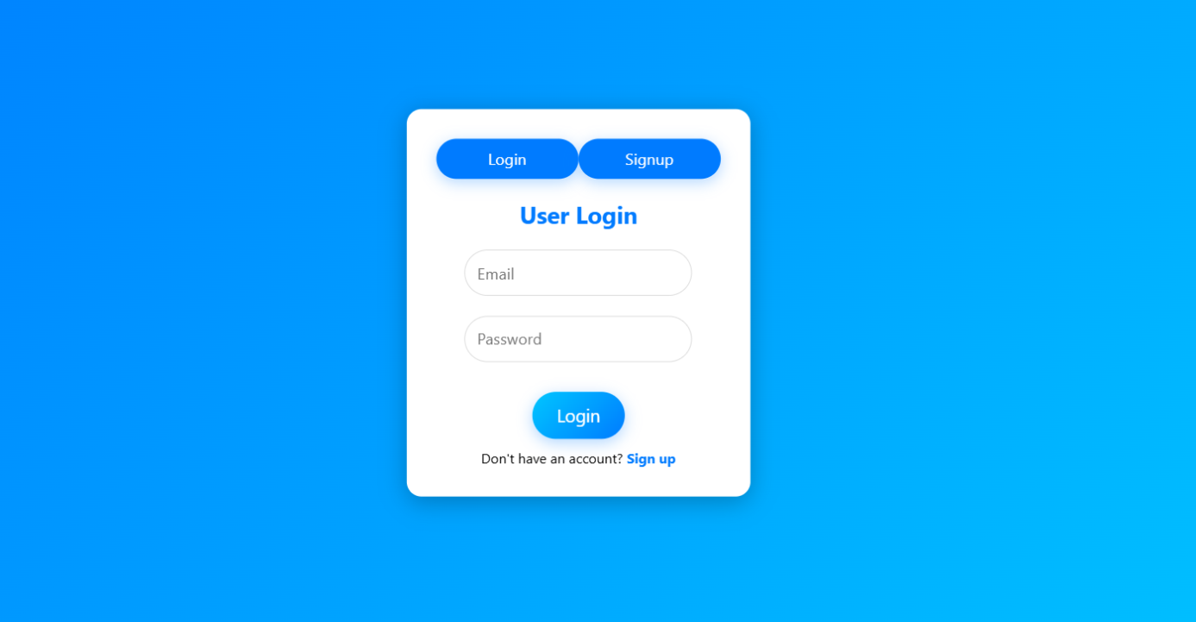
User login page

Slide 24
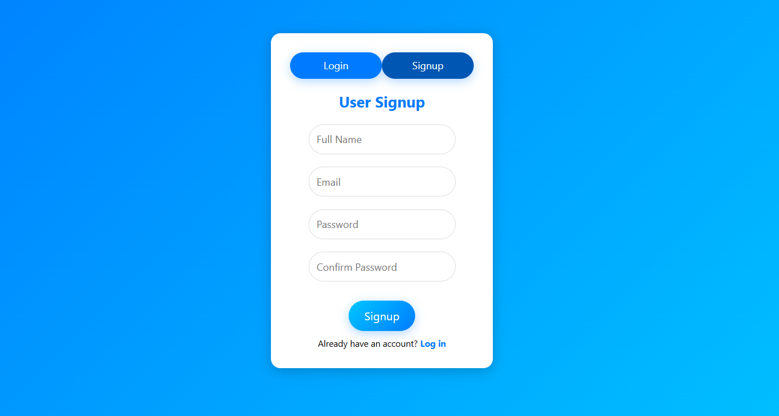
User Signup page

Slide 25
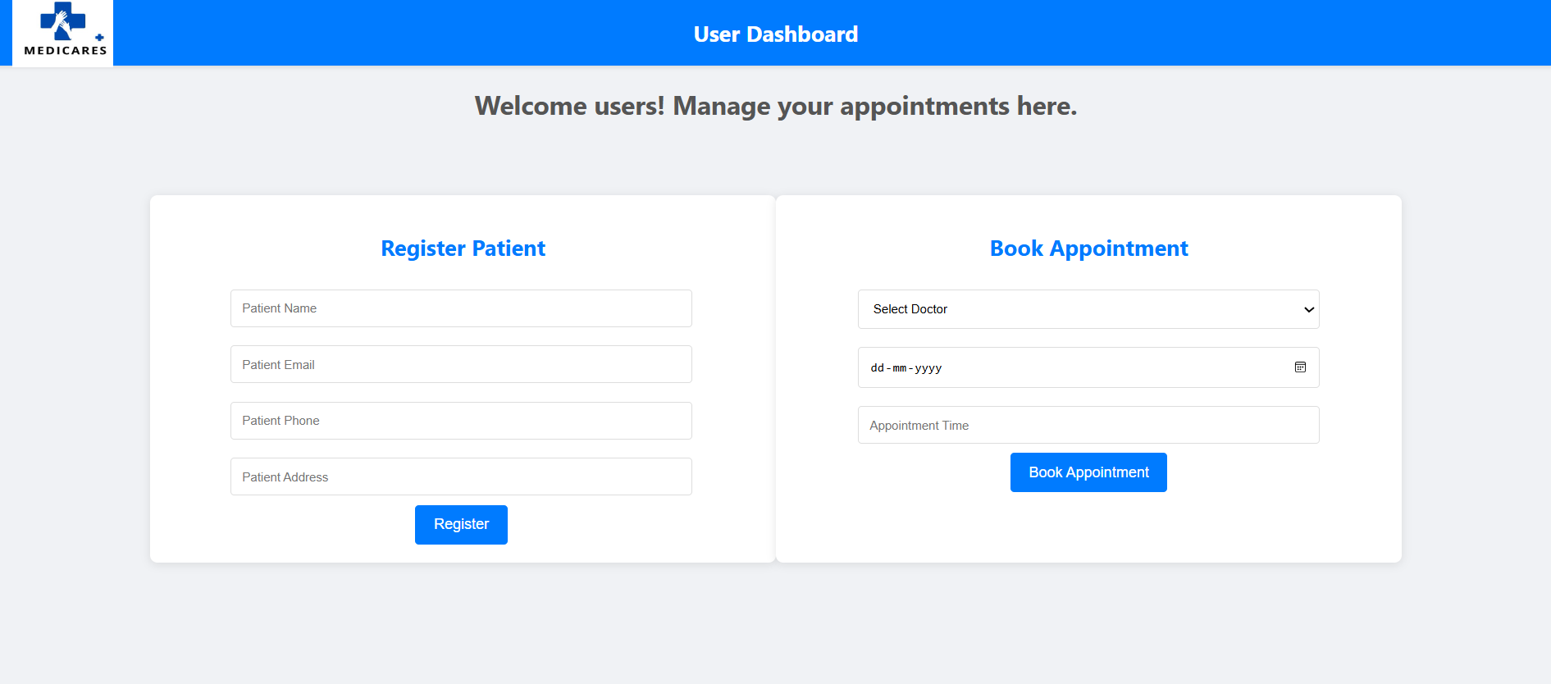
User Dashboard page

Slide 26
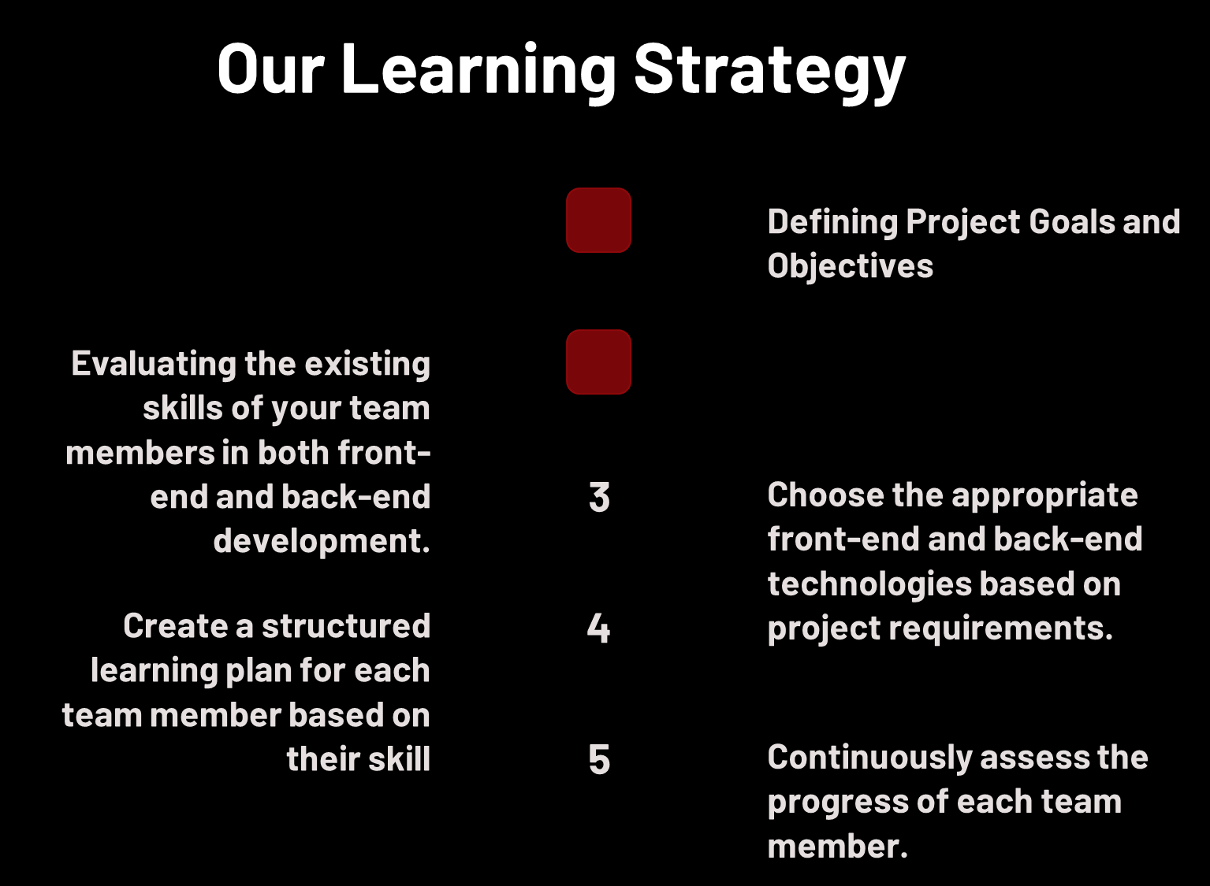
1
2

Slide 27
https://github.com/somusravya/THE-NULL-POINTERS

Slide 28
Thank You

